Slide 1
Law of Supply

Slide 2
The law of supply describes the relationship between price and amount supplied when all other variables remain constant (ceteris paribus). Price is a dominant factor in the determination of the supply of a commodity. As the price of a commodity increases, the supply of that commodity in the market also increases and vice-versa. This behaviour of the producers is studied through the law of supply.

Slide 3
Assumptions of Law of Supply
The phrase "keeping other factors constant or ceteris paribus" is used when describing the law of supply. This expression refers to the following presumptions that the law is based on:
The price of other commodities is constant.
The state of technology has not changed.
The price of factors of production is constant.
The taxation laws remain the same.
The producer's objectives are constant.

Slide 4
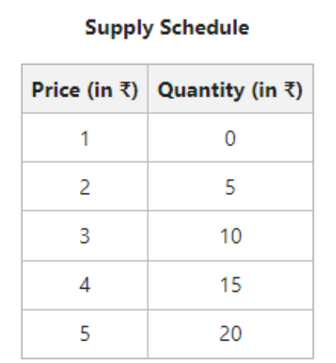

Slide 5
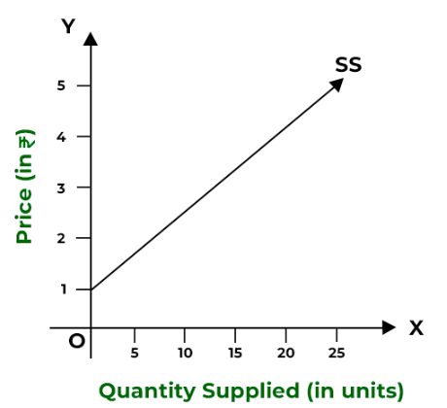
Supply Curve

